Slide 1
Generating Captions for Images using CNN and LSTM
Presented by:
Aditi Akhilesh
Amrita Prakash
Shivani Bapuji Vhatkar
Vaishnavi Pravin Apsingkar

Slide 2
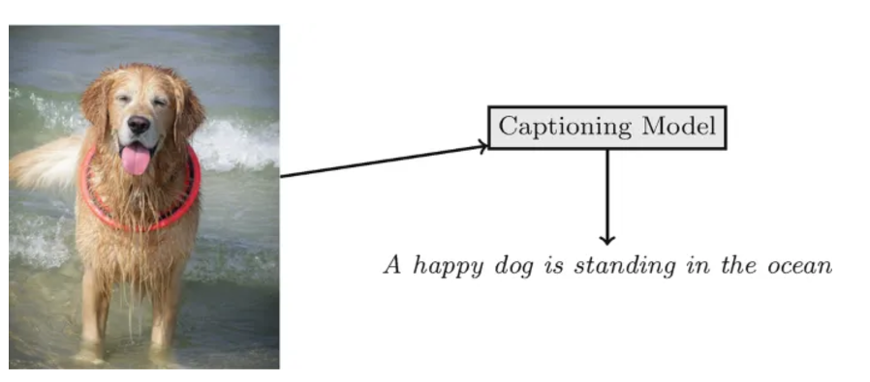
Introduction
What is Image captioning?
Combines Computer vision and Natural Language Processing
Recognizes image context and describes it in natural human language (ex. English)
In simple words, converting image into text
Applications
Automatic content creation
Accessibility tools for the visually impaired
Enhancing search engines for image search

Slide 3
Objective
Building a model for generating accurate, coherent captions for images
Understanding CNN (Convolutional Neural Network) and LSTM (Long Short-Term Memory) models
Using CNN for feature extraction and LSTM for sequence generation

Slide 4
Dataset
Flickr_8k dataset is used
Includes
8091 images
Each image has 5 textual captions
Lightweight dataset
Less computational cost
Small but effective for prototyping.

Slide 5
Data Preprocessing
Image Data:
Resized to 224x224 pixels for VGG16.
Features extracted and stored using pickle for efficiency.
Text Data:
Cleaned captions: Removed punctuation, digits, and converted to lowercase.
Added start/end tokens: "startseq ... endseq".
Tokenized captions : Converting text captions into numerical representations.
Example of text preprocessing:
Before: "A child in a pink dress climbing stairs."
After: "startseq a child in a pink dress climbing stairs endseq"

Slide 6
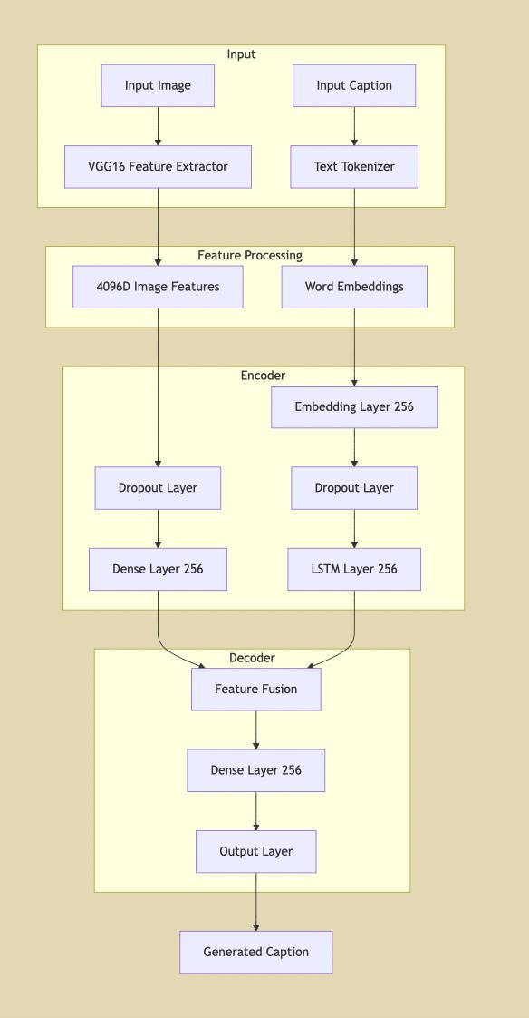
Model architecture
Encoder-decoder structure
2 pre-processing layer.
Encoder-Dense Layer: Most important 256 features captured.
LSTM: captures sequential relation among words in caption.
Decoder-Dense Layer: Studies pattern from combined feature.

Slide 7
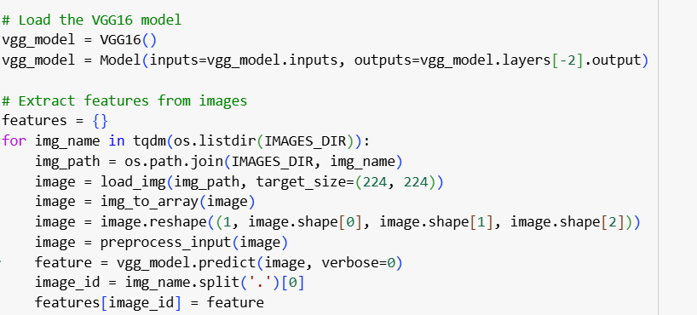
Implementation of CNN
Pre-trained model VGG16 is used for feature extraction
VGG16:
16 layer deep convolutional network
Trained on Imagenet dataset with 1000 classes
Classification layer removed.
Steps:
Load VGG16 with pre-trained weights
Restructure the model to output from penultimate layer (4096 features )
Preprocess the images
Resizing to 224x224 pixels
Convert to numpy array and normalize
Feed the images into CNN to extract feature vectors

Slide 8
Implementation of LSTM
LSTM is type of RNN (Recurrent Neural Network) model
LSTM:
Ideal for handling sequential data
Used to generate caption word by word based on features of image and the previous words
This layer has 256 neurons
Steps:
Takes input from Embedding layer and passes it to Dropout layer
Selects the word with maximum probability.
Output is combined with image features using add().

Slide 9
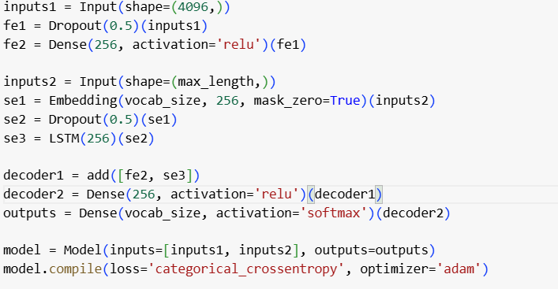
Experimental Setup
Dataset Split: 90% training, 10% testing.
Training Details:
Batch size: 64.
Epochs: 25.
Optimizer: Adam(Adaptive Moment Estimation)
To minimize the loss function during training.
For loss function, we have used categorical cross - entropy

Slide 10
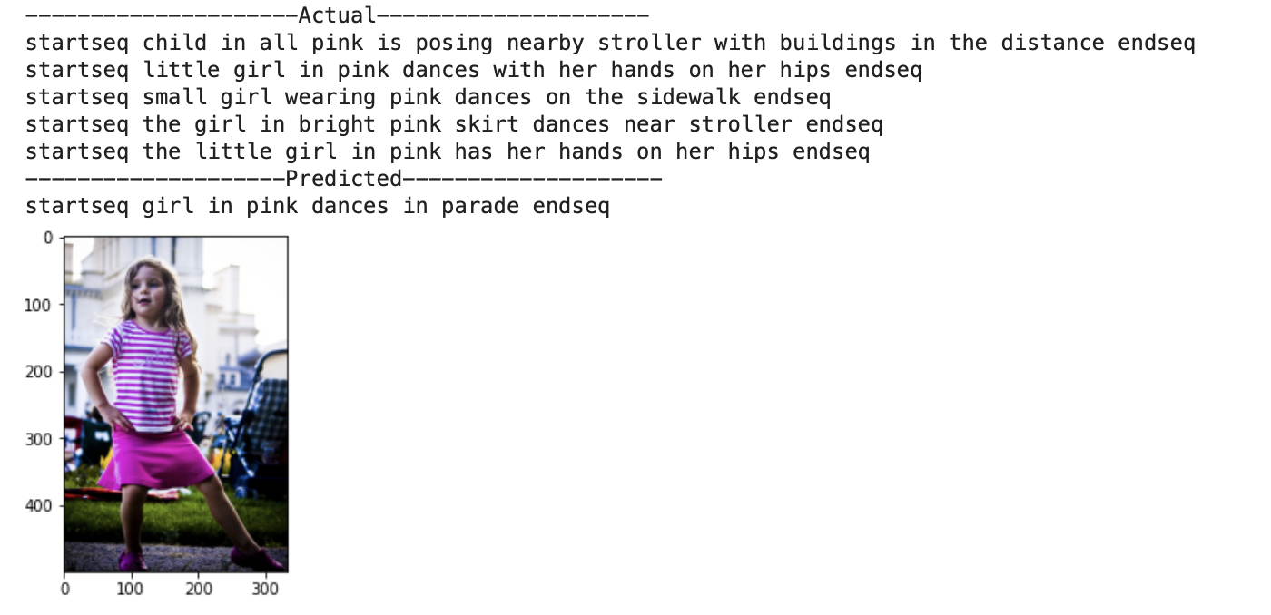
Outputs

Slide 11
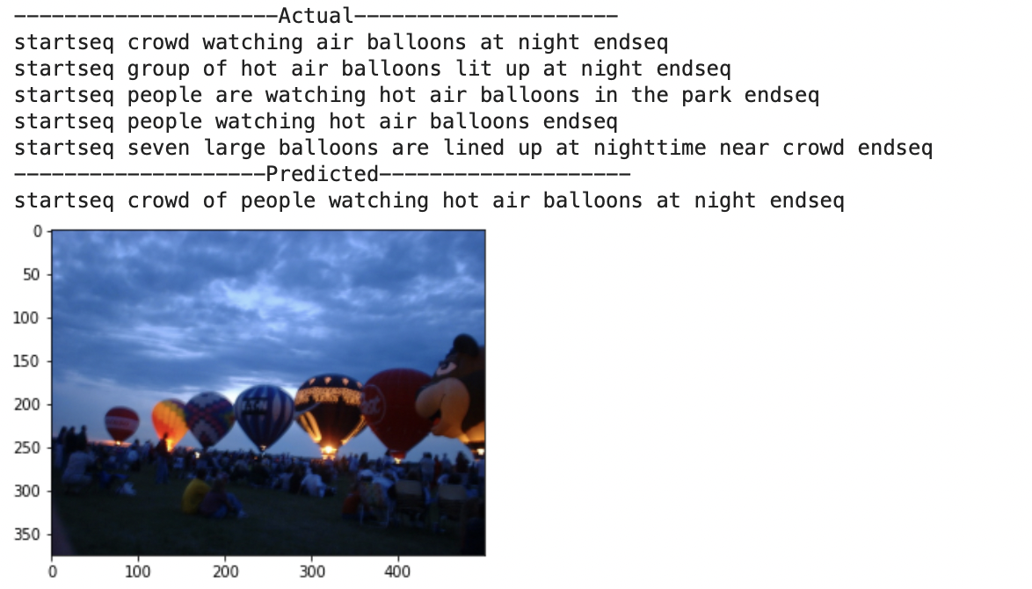
Outputs

Slide 12
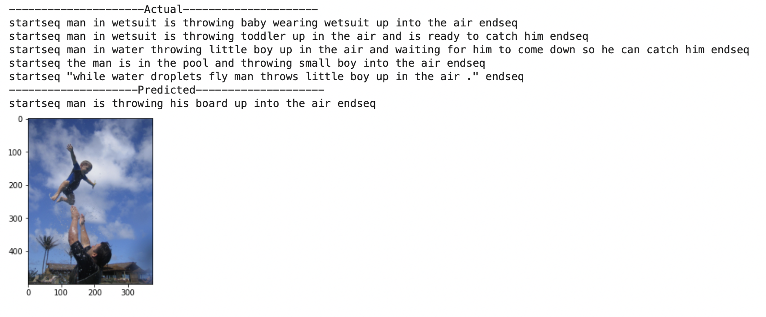
Outputs

Slide 13
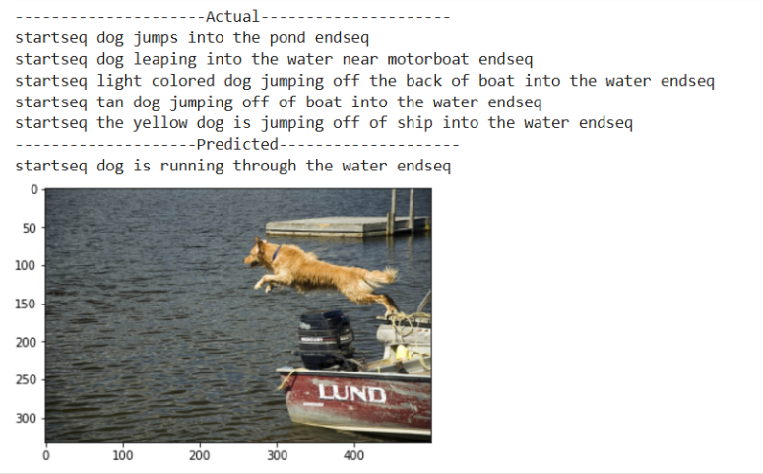
Outputs

Slide 14
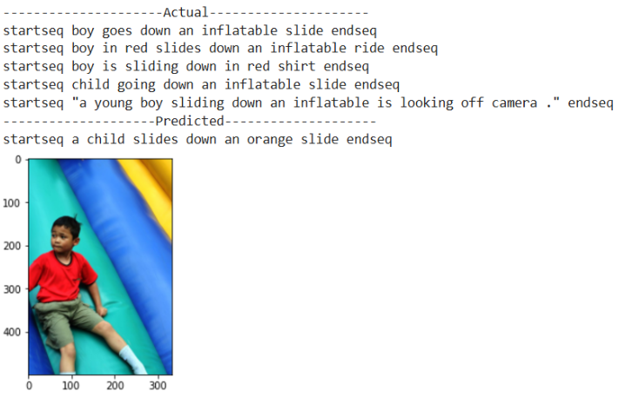
Outputs

Slide 15
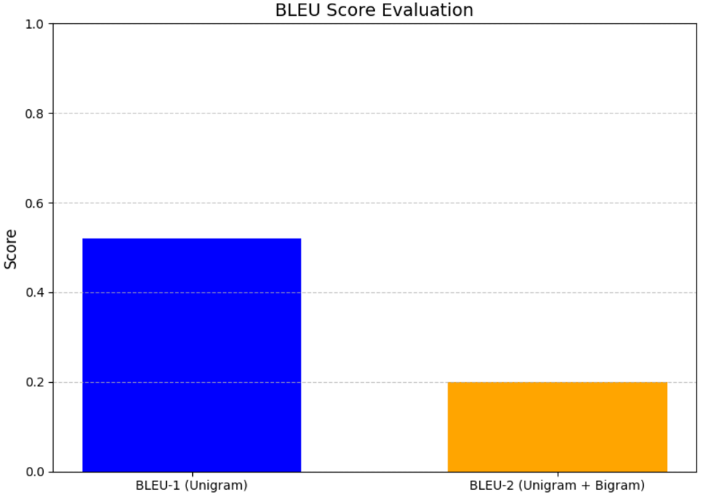
Evaluation
BLEU (Bilingual Evaluation Understudy) Score measures the quality of text generated by comparing it to one or more reference texts.
BLEU-1 (Unigram): Measures the overlap of individual words.
BLEU-2 (Unigram + Bigram): Considers both individual words and pairs of consecutive words.
Tested with test dataset(10%)

Slide 16
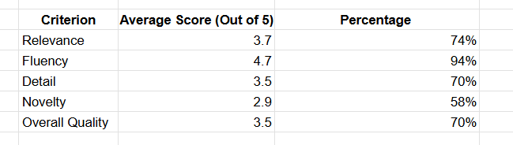
Evaluation
Process:
Selected few images from the test dataset.
Conducted an evaluation based on human feedback by asking specific questions.
Evaluation Criteria:
Relevancy: How closely does the caption match the content of the image?
Fluency: Is the caption grammatically correct and natural?
Detail: Does the caption provide sufficient information about the image?
Novelty: Is the caption unique and non-repetitive?
Link

Slide 17
Challenges and limitations
Training on larger datasets requires significant time and resources.
Fine-tuning pre-trained CNNs for improved feature extraction.
BLEU score improvement through better tokenization and hyperparameter tuning.

Slide 18
Discussion and future work
Train on larger datasets (e.g., Flickr30K dataset, MSCOCO).
Experiment with advanced architectures (e.g., Transformers).
Integrate real-time captioning for live feeds.

Slide 19
Personal Takeaways
Technical Insights:
Improved understanding of computer vision and NLP techniques.
Learned to build encoder-decoder models and use VGG16 for feature extraction.
Gained experience in text preprocessing and model evaluation using BLEU scores.
Problem-Solving Strategies:
Developed effective methods to break down complex tasks.
Efficiently accessed resources through documentation and forums.
Refined model performance through iterative testing.

Slide 20
Conclusion
Successfully built an image caption generator using CNN and LSTM.
Demonstrated the ability to describe images with reasonable accuracy.
Encouraging results with BLEU score and meaningful captions.

Slide 21
Any questions?
Thank you!

Slide 22
References
Flickr8k Dataset: https://github.com/jbrownlee/Datasets/releases
Pre-trained VGG16 Model: Simonyan, K., & Zisserman, A. (2014). Very Deep Convolutional Networks for Large-Scale Image Recognition
https://arxiv.org/abs/1409.1556
BLEU Score: Papineni, K., Roukos, S., Ward, T., & Zhu, W. J. (2002). BLEU: a method for automatic evaluation of machine translation
https://aclanthology.org/P02-1040/
NLTK Documentation for BLEU Scoring: https://www.nltk.org/_modules/nltk/translate/bleu_score.html

